Slide 1

Class 804
Testing Java Applications Using the Eclipse Test and Performance Tools Platform (TPTP)
Paul Slauenwhite
IBM Rational Software

Slide 2
Agenda
Introduction
  Speaker
  Participants
TPTP Project
  Mandate
  Participants
  Composition
  Architecture
Agent Controller
  Architecture
Eclipse Modeling Framework
TPTP EMF Data Models
  Testing Profile
  Behavioral
  Execution History

Slide 3
Agenda
TPTP Test Tools
  Test Perspective
  Datapools
  Execution Environment
  Test Logs
  Reports
  Manual Testing
  JUnit Testing
  URL Testing
  Automated GUI Testing
Conclusion
  Project Extensibility
  Future work
  Resources
Questions, Answers and Discussion

Slide 4
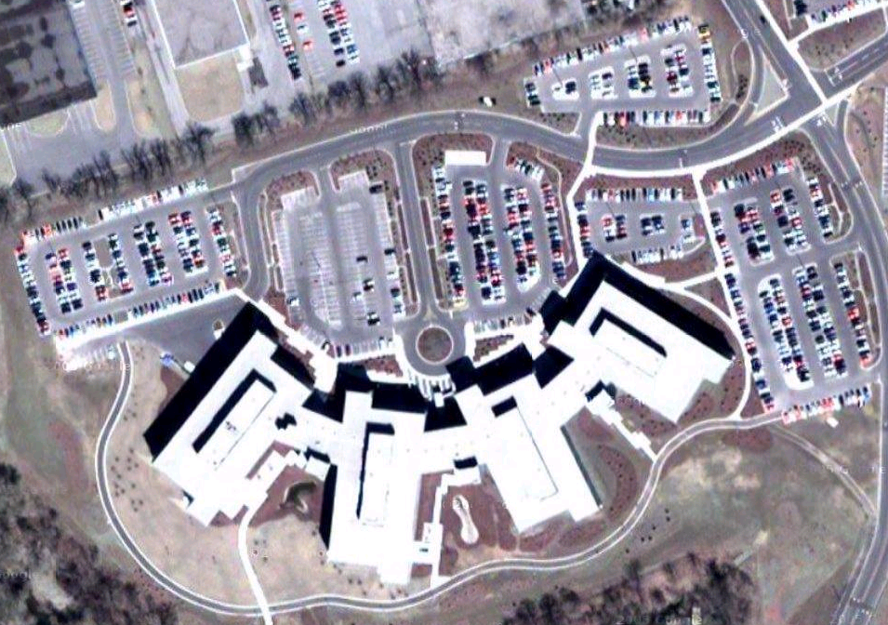

Introductions - Speaker
Paul Slauenwhite
  Software Developer
  TPTP Test Project Lead
  IBM Rational Software
  Toronto Software Lab
  paules@ca.ibm.com
Source: Google Maps
(http://maps.google.com/maps?f=q&hl=en&q=8200+warden+avenue,+markham&ll=43.849287,-90.338418&spn=0.002809,0.007381&t=k)
Notes:
Paul Slauenwhite
Software Developer
TPTP Test Project Lead
IBM Rational Software
Toronto Software Lab
paules@ca.ibm.com
Paul Slauenwhite is a Software Developer on the IBM Autonomic Computing (AC) Tools and Technologies project and a committer to the Eclipse Test and Performance Tool Platform (TPTP) open-source project (formally Hyades). After receiving a B.Sc. in Computer Science from Dalhousie University, Paul joined IBM in 2000 and worked on WebSphere Object Level Trace (OLT) project. In 2001, he joined the IBM WebSphere Studio Team and developed logging and tracing technologies. Paul moved to the Eclipse Hyades project at its inception in 2002, focusing on log and trace data, collection, and correlation. Paul is currently working on a M.Math in Software Engineering at the University of Waterloo.

Slide 5
Introductions – Participants
What is your level of experience with Eclipse?
  First time user.
  Casual user.
  Frequent user.
  Contributor/committer.
What is your familiarity with TPTP?
  What is TPTP?
  Casual user.
  Frequent user.
  Trying to find a wireless signal to check my mail.

Slide 6
TPTP Project - Mandate
Started in 2002 as an Eclipse tools subproject named Hyades.
Promoted in 2004 to an Eclipse project and renamed as the Test and Performance Tools Platform (TPTP) project.
Open-source platform providing an extensible framework for Automated Software Quality (ASQ) tools including reference implementations for testing, tracing, tuning and monitoring software systems running on a range of target platforms.
Goals:
  Platform of choice for test, performance, and monitoring tools
  Exemplary tools
  Enables value-added third-party tooling through extensibility and high-quality APIs
Principles:
  Extension of the Eclipse Value Proposition
  Vendor Ecosystem
  Vendor Neutrality
  Standards-Based Innovation
  Agile Development
  Inclusiveness & Diversity
Mission:
“to build a generic, extensible, standards-based tool platform upon which software developers can create specialized, differentiated, and interoperable offerings for world class test and performance tools.”
Notes:
-The Eclipse Test and Performance Tools Platform (TPTP) Project provides an open platform supplying powerful frameworks and services that allow software developers to build unique test and performance tools—both open source and commercial—that can be easily integrated with the platform and with other tools. The TPTP Platform addresses the entire test and performance lifecycle, from early testing to production application monitoring, including test editing and execution, monitoring, tracing and profiling, and log analysis capabilities. The platform supports a broad spectrum of computing systems including embedded, standalone, enterprise, and high-performance and will continue to expand support to encompass the widest possible range of systems. TPTP will change the approach to application lifecycle management, affecting IT organizations and tool vendors alike. Not only TPTP-based tools are interoperable, but they also are tightly integrated with the Eclipse Platform-based development tools. An IT organization will be able to assemble just the right combination of tools from different vendors that it needs throughout the application lifecycle, from development through production. On the other hand, TPTP will enable the emergence of completely new tool models that simultaneously leverage and integrate multiple data across the lifecycle yielding advanced capabilities and productivity.
-The Project will extend the family of Eclipse technologies to provide an open development platform supplying frameworks and services for test and performance tools that are used throughout the lifecycle (e.g., testing, tracing/profiling, tuning, logging, monitoring, analysis, autonomics, administration, etc., but not development tools such as optimizing compilers) and support a spectrum of computing systems, from standalone through highly-distributed, and from embedded to enterprise. For example, integrated with Eclipse UI and development (JDT/CDT) and deployment (WTP) tools built on Eclipse.
-The project will also deliver exemplary tools that verify the utility of and illustrate the appropriate use of the platform, support the development and maintenance of the platform itself, and are extensible via documented programmatic interfaces.

Slide 7
TPTP Project - Participants
Eclipse Strategic Developers:
  Computer Associates
  Compuware
  IBM
  Intel
  Scapa Technologies
Eclipse Strategic Consumers:
  SAP
Eclipse Add-in Providers:
  FOKUS
  OC Systems

Slide 8
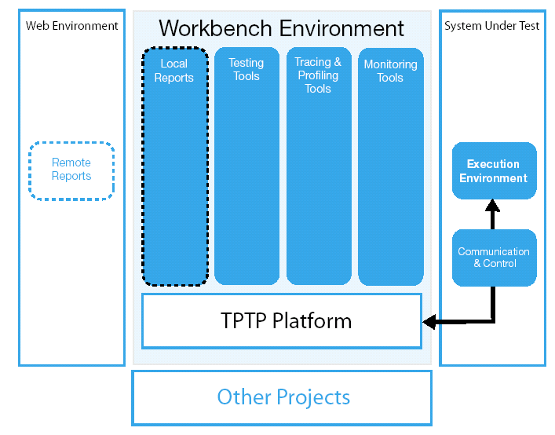
TPTP Project - Composition
TPTP is composed of 4 projects:
  Platform
  Test
  Trace and Profiling
  Monitoring
Each project is divided into technology domains:
  UI
  Analysis
  EMF Model
  Collection Control
  Communications
  Execution
  Agents/Events
  Doc
Each technology domain divided into components, each with an assigned lead committer.
Notes:
-Platform Project: Covers the common infrastructure in the areas of user interface, EMF based data models, data collection and communications control, remote execution environments and extension points
-Test Tools Project: Provides specializations of the platform for testing and extensible tools for specific testing environments, initially 3 test environments: JUnit, manual and URL testing
-Tracing and Profiling Project: Extends the platform with specific data collection for Java and distributed applications that populate the common trace mode, also viewers and analysis services
-Monitoring Project: Collects, analyzes, aggregates and visualizes data that can be captured in the log and statistical models

Slide 9
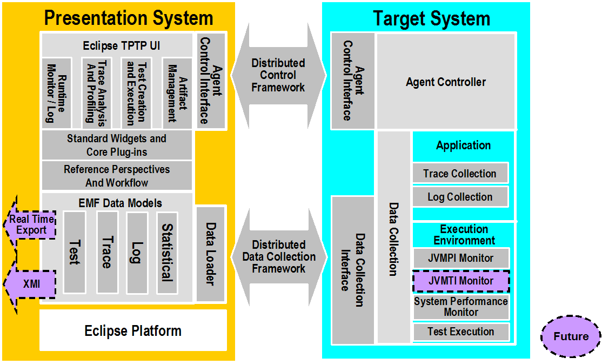
TPTP Project - Architecture
Future
Notes:
-Organized around a client or presentation system and server or target system which may or may not be on the same physical machines.

Slide 10
Agent Controller
Standalone component independent of the TPTP workbench.
Flexible service/daemon that resides on each local or remote deployment host.
Used to launch new processes and attach to agents that coexist within processes.
Provides extensible agent architecture for control capabilities (e.g. launch, pause and attach) and native data collection by monitoring clients (e.g. TPTP workbench).

Slide 11
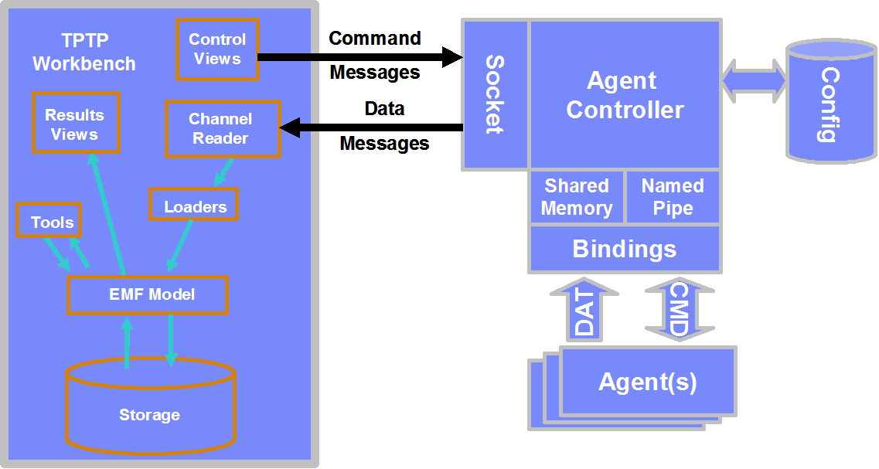
Agent Controller – Architecture
Notes:
The Agent Controller resides on any SUT host as a daemon. A typical scenario for a monitoring session would first involve the Eclipse Workbench connecting to the AC daemon on the SUT host and asking the AC to create an agent. The AC would start the agent process and establish communications with it. The Eclipse Workbench would then possibly issue some commands directly to the agent to specify the data the agent should send back. The agent would then begin to send back standard TPTP XML fragments to be loaded into any of the TPTP data models. These XML fragments would be returned by the AC to the Eclipse workbench where a standard XML fragment loader would parse the fragments and convert them into TPTP data model data (e.g. entries in an observation in a TPTP statistical model). These standard models could then be viewed by the user using TPTP views.

Slide 12
Agent Controller – Architecture
Supported platforms include:
  AIX® (PPC)
  HP-UX (RISC)
  LinuxTM (IA32)
  LinuxTM (PPC64)
  LinuxTM (zSeries)
  OS/400® (iSeries)
  Solaris (SPARC)
  WindowsTM (IA32)
  WindowsTM (IPF)
  WindowsTM (EM64T)
  Z/OS® (zSeries)

Slide 13
Eclipse Modeling Framework (EMF)
Framework and code generation facility for designing and implementing applications based on a structured data model.
Data models are used to describe data objects, attributes and relationships.
Data models may be designed using annotated Java, XML, or UML class diagrams and converted to an EMF model specification defined in XML Metadata Interchange (XMI).
The XMI model specification is used to generate the Java implementation classes for the data model, a set of adapter Java classes that enable viewing and command-based editing of the data model, and a basic editor UI.
The generated Java implementation classes are used to instantiate, load and persist in-memory data models.
A resource persistence layer is provided to permit file system abstractions, such as flat files or a relational database.
Provides a framework for the mechanical creation of data models that are the foundation for interoperability with other EMF-based applications.

Slide 14
TPTP EMF Data Models
EMF data models are used in TPTP as an integration point.
TPTP User Interface and Execution Environment are build around the TPTP EMF data models.
TPTP contains four core EMF data models:
  Trace
  Log
  Statistical
  Test
    Testing Profile
    Behavioural
    Execution History
Data models are populated by model loaders consuming structured XML fragments originating from a variety of sources.

Slide 15
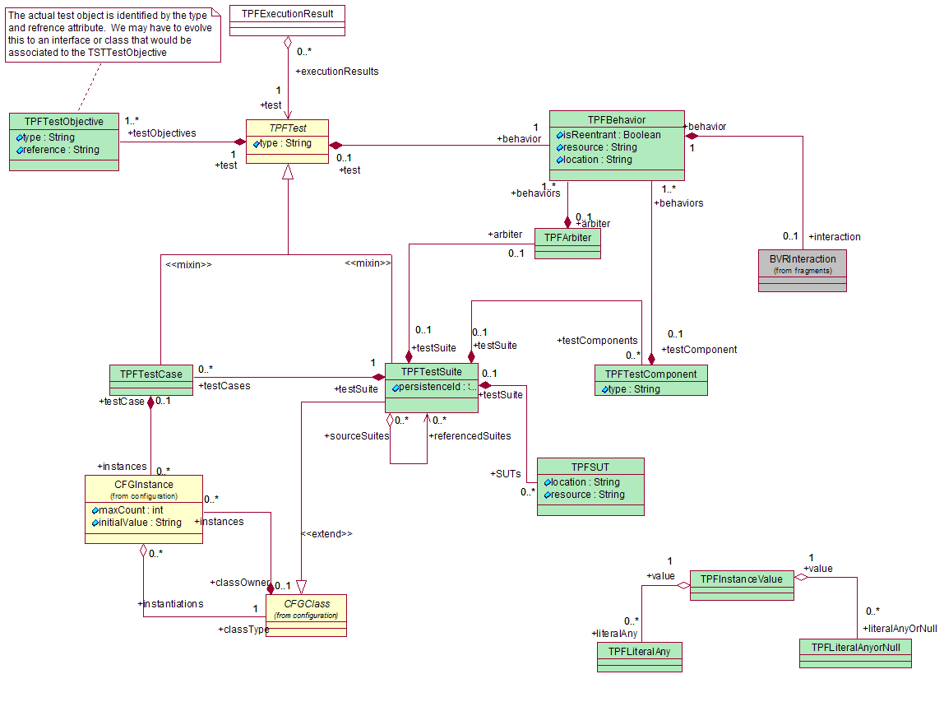
TPTP Test Models

Slide 16
TPTP Test Models – Testing Profile
Reference implementation of the UML2 Test Profile’s standalone MetaObject Facility (MOF) model.
  Part of the finalization process in the OMG’s acceptance of the UML2 Test Profile submission.
Definition model for the creation, definition and management of test artifacts.
Test artifacts include:
  Test suites.
  Test cases.
  Datapools.

Slide 17
TPTP Test Models – Behavioural
Implementation of the UML2 Interactions meta model.
Used for defining the behaviour of test suites including:
  Loops.
  Invocations:
    Test cases within the test suite defining the behaviour.
    Other test suites and/or test cases (hierarchal).
  Synchronization.
Façade provided:
  Semantically familiar programming model (e.g. loops instead of combined interaction fragments).
  Interoperability among tests from different test tool vendors (multiple ways of representing the same transaction).
  Access to behavior that is not modeled (via another implementation of the same façade interface).

Slide 18
TPTP Test Models – Execution History
Definition model for the creation, definition, management and persisting of test executions over time.
Test executions include:
  Tests to be executed.
  Deployments.
  Locations.
  Verdicts.
  Attachments.
  Messages and console output from the test execution.
A collection of test execution traces and results, commonly referred to as a test log.
Extensible with custom attributes.

Slide 19
TPTP Test Tools
Common framework for testing tools thereby integrating disparate test types and execution environments.
Extends the TPTP Platform:
  Common perspectives and views for interacting with target systems and resources.
  Reference navigators, viewers, editors and wizards through extension points.
  Standard EMF data model, query framework and assets repository.
  Common data collection and execution framework on local and remote targets.
Includes several test tool reference implementations:
  Manual testing.
  JUnit and JUnit Plug-in testing.
  URL testing.
  Automated GUI Recording/Playback

Slide 20
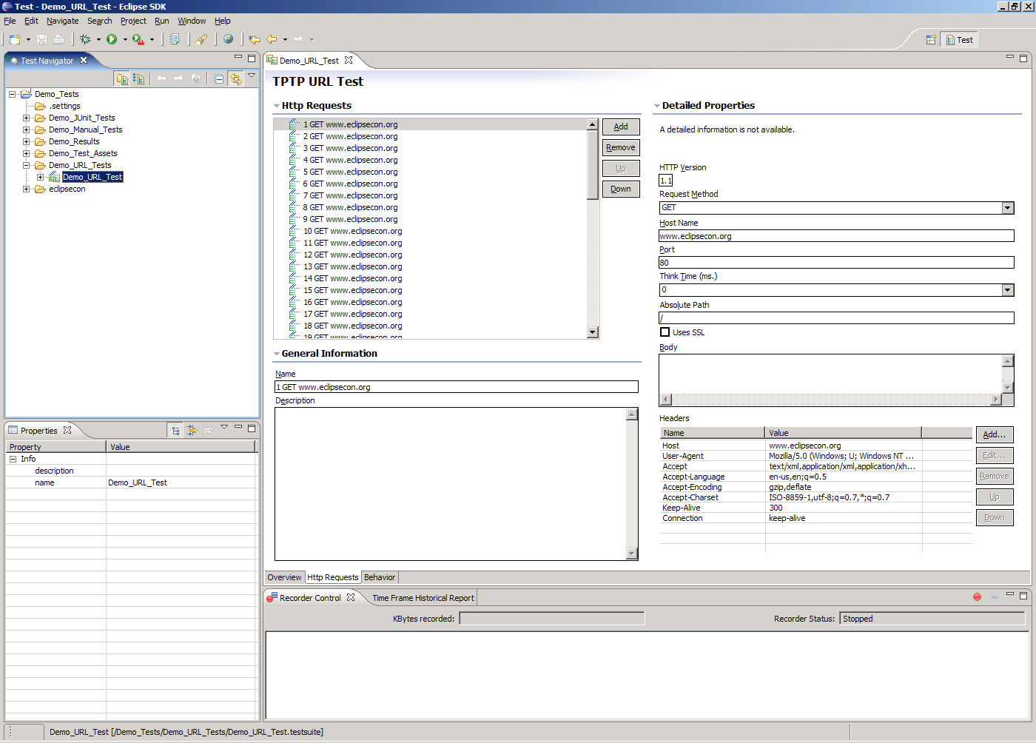
TPTP Test Tools – Test Perspective
Set of navigators, viewers, editors and wizards for creating, viewing, editing and navigating tests and test assets including:
  Artifacts:
    Test suites.
    Test cases.
    Datapools.
  Recordings.
  Deployments.
  Locations.
  Execution histories.
  Reports.

Slide 21
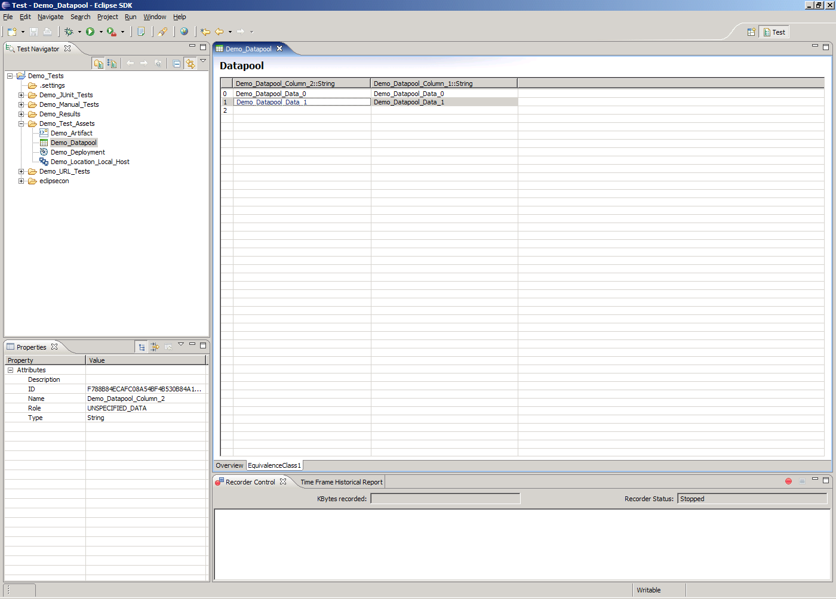
TPTP Test Tools – Datapools
Provides variable data to tests during execution:
  Equivalence Class: Subset of data that produces the equivalent pass/fail result.
  Variable: Named and typed data (column) within an equivalence class.
  Record: Slice of data (row) of one or more variables.
Datapool variables are associated with test input and output for substitution of equivalence classes during execution.
Support for importing large volumes of two-dimensional data from CSV files.

Slide 22
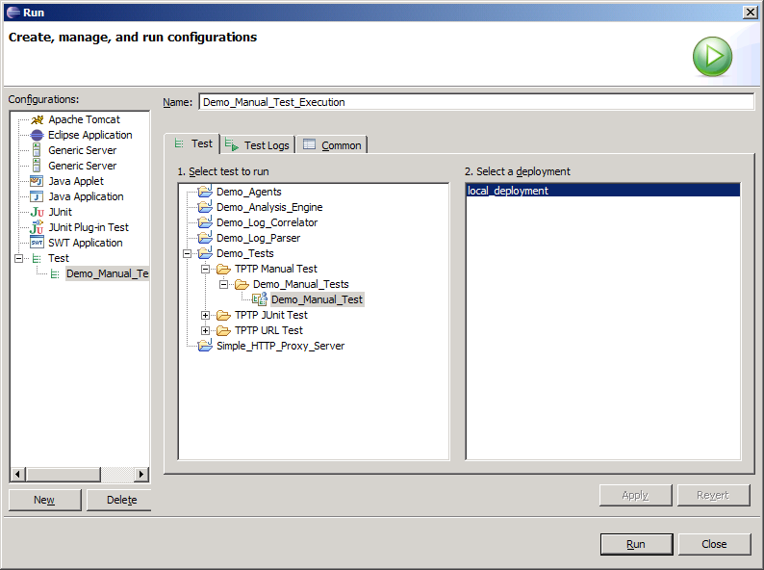
TPTP Test Tools – Test Execution
Tests are typically executed from the TPTP workbench using a launch configuration.
Execution includes:
  Test assets deployed to the target environment through the Test Execution Harness.
  Typed test runner invoked to execute the test.
  Execution events routed through the test agent back to the TPTP workbench.
  Execution events loaded into the execution history model.
An automatable test execution service is provided for launching tests programmatically via scripts (e.g. shell and ANT) and external applications (e.g. Java).
Notes:
Launch configurations may be ran in profiling mode for method level code coverage.

Slide 23
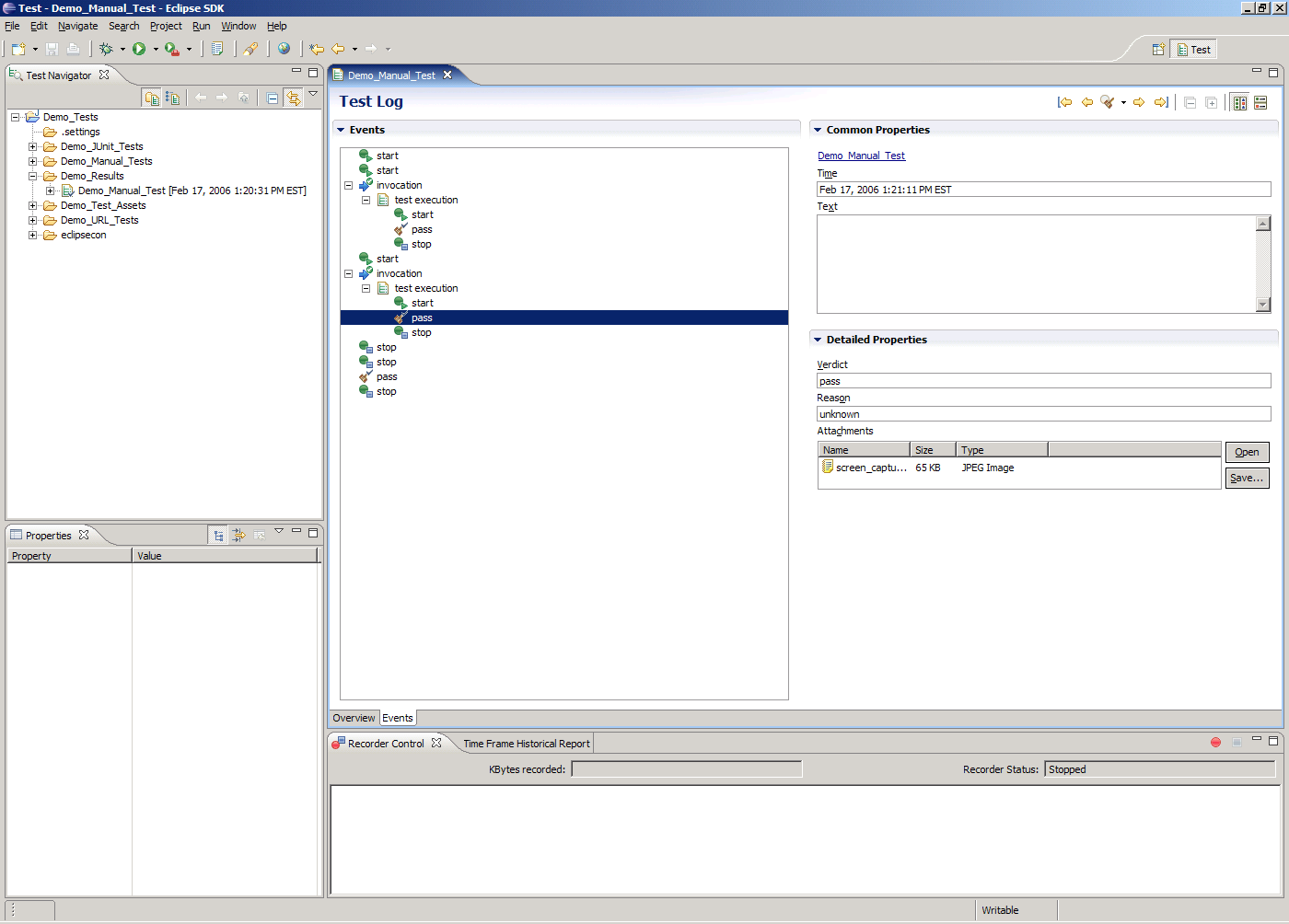
TPTP Test Tools – Test Logs
Executed tests produce test logs for persistence, reporting and historical analysis.
Test logs include:
  Tests to be executed.
  Deployments.
  Locations.
  Verdicts.
  Attachments.
  Messages and console output from the test execution.
  -Defect tracking.
Viewer to summarize, view, navigate and filter test logs.

Slide 24
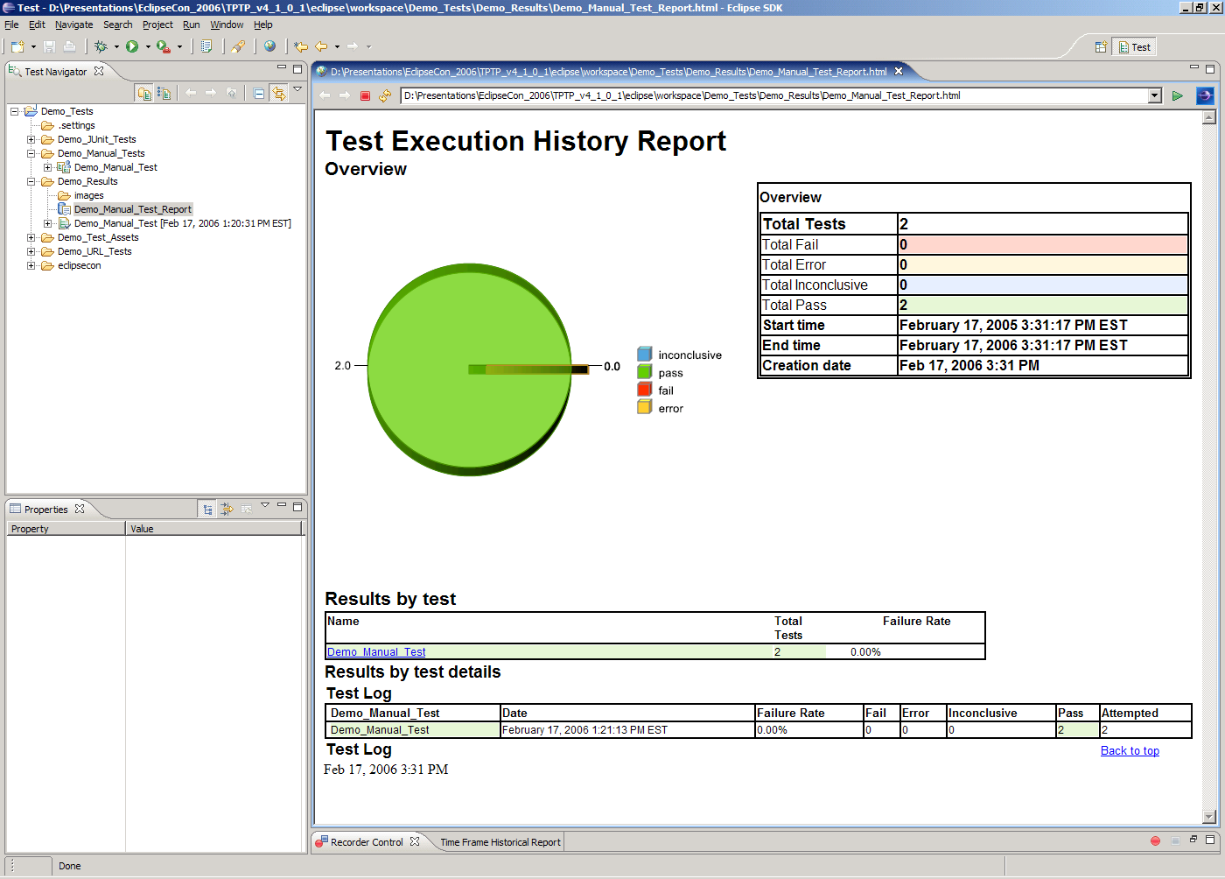
TPTP Test Tools –Reports
Aggregates and summarizes numerous test executions over a period of time (report window).
Integrated with BIRT for defining custom report templates.
Extension points and preferences to provide custom report generators to create custom content.
Existing report generators include:
  HTML Test Pass (BIRT)
  HTTP Page Hit Rate
  HTTP Page Response Time
  Test Pass
  Time Frame Historic
  XML Test

Slide 25
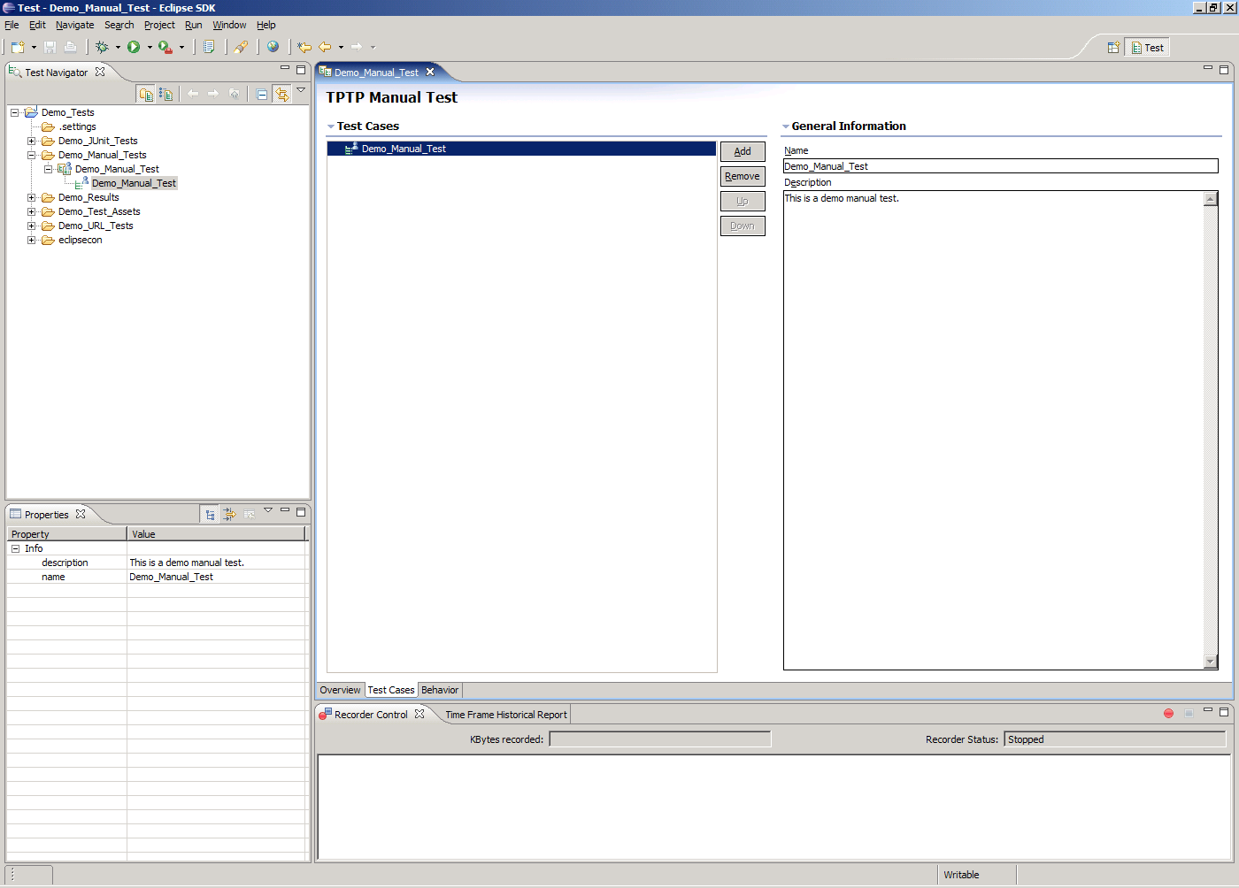
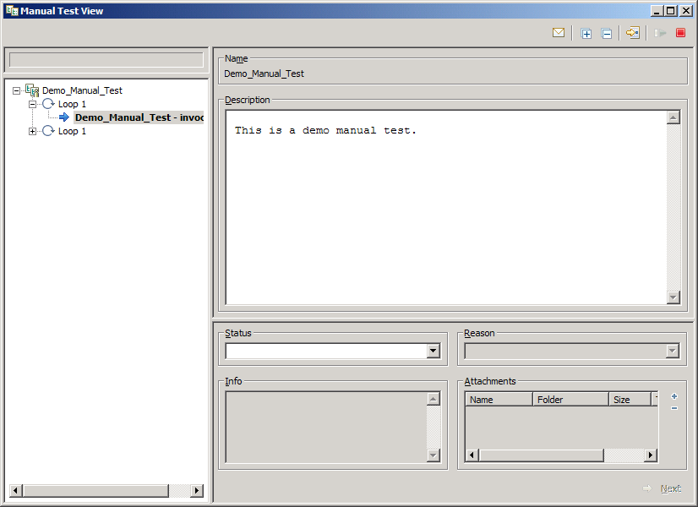
TPTP Test Tools - Manual Testing
Manual testing of applications by human testers based on textual test descriptions (plain text or HTML).
Editor for creating manual test suites and defining tests and their behavior.
Manual test runner for local and remote execution.
Manual Test View for executing a manual test on the target environment by allowing the tester to step through the manual test and capture messages and results:
  Verdicts.
  Reasons.
  Information.
  Attachments.

Slide 26
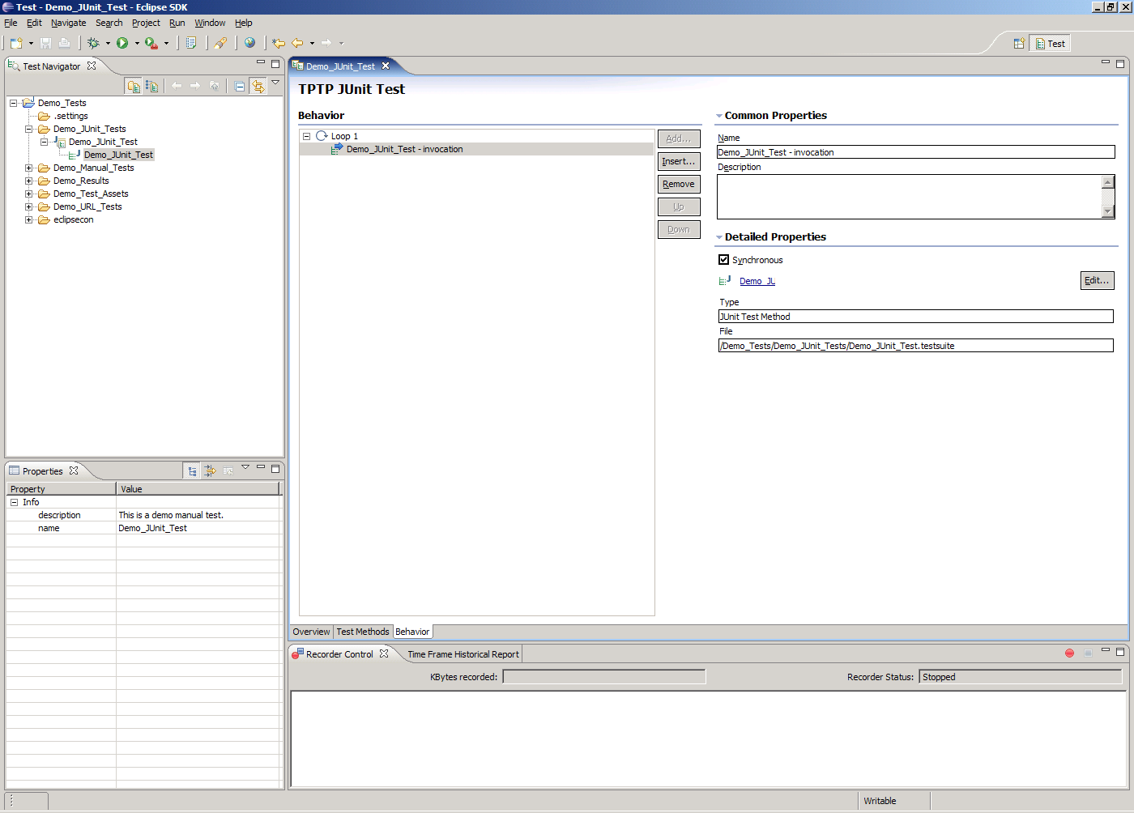
TPTP Test Tools - JUnit and JUnit Plug-in Testing
Automated unit testing of applications and plug-ins based on JUnit test classes.
Editor for creating JUnit and JUnit plug-in test suites and defining metadata, tests and their behavior.
JUnit test classes generated and synchronized automatically from the test suite while preserving user modifications.
Wizard for creating TPTP JUnit and JUnit plug-in tests from existing JUnit and JUnit plug-in test classes without source modification.
JUnit test runner for local and remote execution.

Slide 27
TPTP Test Tools - URL Testing
Automated HTTP performance testing of Web applications and plug-ins based on JUnit test classes.
Editor for creating URL test suites and defining tests (HTTP requests) and their behavior.
HTTP proxy recorder to intercept and record HTTP requests from user interactions with Web applications to create an URL test suite.
URL test runner for local and remote execution.

Slide 28
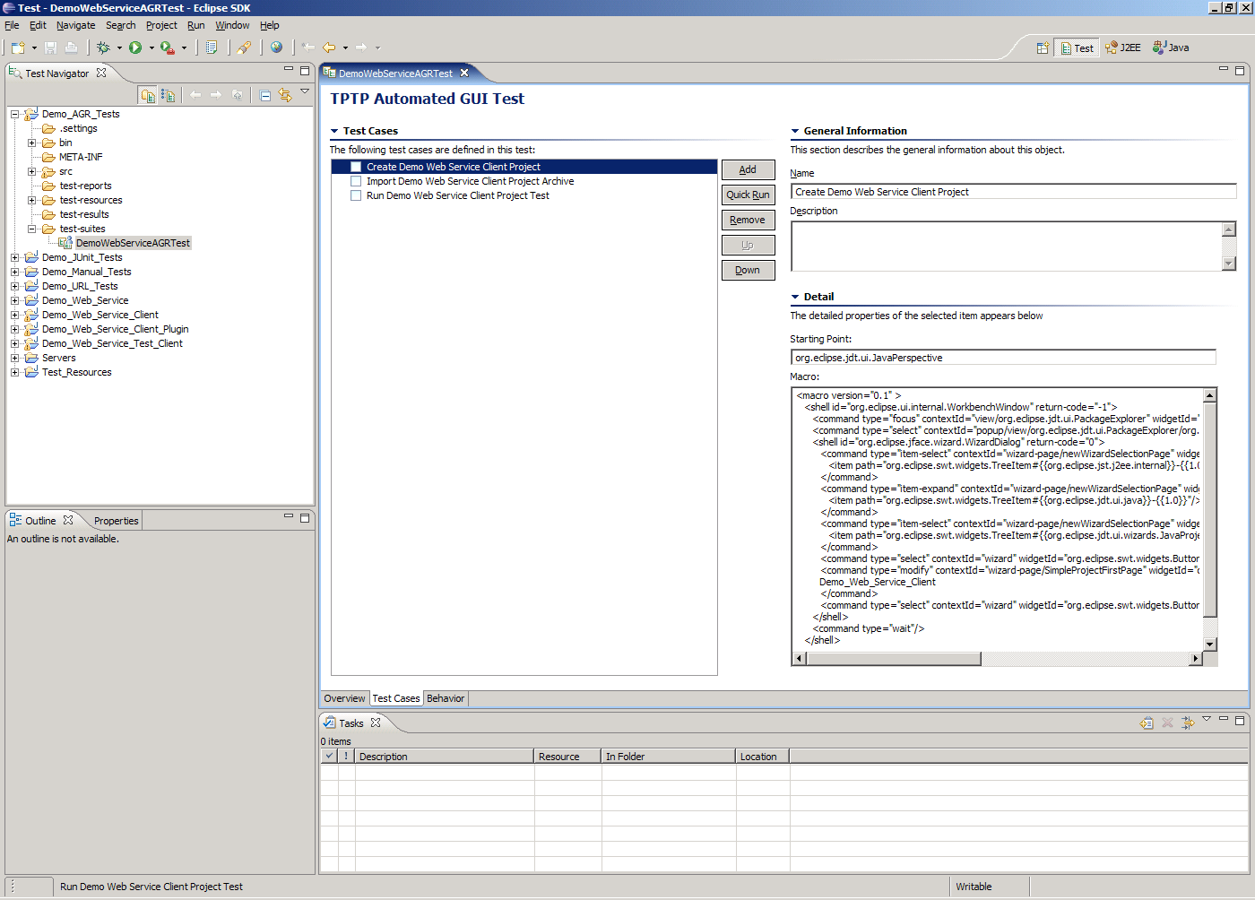
TPTP Test Tools – Automated GUI Testing
Automated GUI Recorder (AGR) for testing Eclipse-based UIs.
Editor for creating automated GUI test suites and defining tests and their behavior.
Positional and object-based GUI recorder to intercept and record user interactions with UI widgets in the workbench to create an automated GUI test suite with datapools and verification points.
Automated GUI test runner for local and remote execution.

Slide 29
Conclusion
TPTP Test Tools provide a centralized, open-source, flexible and extensible framework for testing tools.
Framework provides tools for creating and managing tests, deployments, datapools, execution histories and reports.
Reference implementations for manual, JUnit, URL and automated GUI testing of applications.

Slide 30
Conclusion - Project Extensibility
Extensible architecture to allow users to define vendor and product specific:
  Test Creation Wizard
    Extension point for defining wizard to create specific types of tests.
  Test Editor
    Extension point provided for associating editor with specific type of test.
  Test Recorder
    Extension point provided for registering a custom test recorder for a type of test.
  Code Generator
    Extension point for registering a custom code generator for a type of test.
  Analyze Results
    Extension point to open Log views used to analyze results of test run.
  Publish Reports
    Extension point for custom report types with custom content.
Several existing industry test products built on TPTP:
  IBM® Rational® Functional Tester, Manual Tester, Application Developer and Software Architect (http://www-306.ibm.com/software/rational/)
  Scapa Test and Performance Platform (http://www.scapatech.com/products_services/intro.html)
Notes:
IBM offers commercial products that leverage the Eclipse platform in both of these ways:
-IBM Rational offers software design and construction tools that are built on top of Eclipse that extend the base IDE with high-productivity visual programming and model-driven development capabilities.
-IBM Rational also offers an array of lifecycle management tools that are built on or plug into Eclipse that expand the framework with capabilities for software quality, requirements management, and software configuration management.

Slide 31
Conclusion - Future Work
4.3 Planned/Completed Work
  Generic Java API recorder.
  Integration between TPTP and JDT JUnit test types.
  Improved documentation, defect fixes and performance improvements.
Future Work
  Web Service test type, wizard, editor, execution and recorder.
  Support for mixed test types.
  Support for automated GUI testing of RCP applications.
  Data Driven Component Testing.

Slide 32
Conclusion - Resources
Eclipse Modeling Framework (EMF):
  http://www.eclipse.org/emf
TPTP Documentation:
  Help >> Help Contents
TPTP Project:
  http://www.eclipse.org/tptp
    Project architecture, organization and plans
    Downloads
    Defects
    CVS
    Developer Resources
    Documentation
    Tutorials
    Mailing Lists
    Newsgroup

Slide 33
Questions, Answers and Discussion
Is there a real requirement in industry for open-source test tools?
What are some common testing activities and obstacles?
Are there viable proprietary extensions to the TPTP test tools?
Possible suggestions for enhancements for the existing TPTP test tools.

Slide 34
Legal Notice
AIX, OS/400, IBM, Rational, and Z/OS are registered trademarks of International Business Corp. in the United States and other countries.
Java and all Java-based trademarks are trademarks of Sun Microsystems, Inc. in the United States, other countries, or both.
Microsoft, Windows, Windows NT, and the Windows logo are trademarks of Microsoft Corporation in the United States, other countries, or both.
Intel, Intel logo, Intel Inside, Intel Inside logo, Intel Centrino, Intel Centrino logo, Celeron, Intel Xeon, Intel SpeedStep, Itanium, and Pentium are trademarks or registered trademarks of Intel Corporation or its subsidiaries in the United States and other countries.
UNIX is a registered trademark of The Open Group in the United States and other countries.
Linux is a trademark of Linus Torvalds in the United States, other countries, or both.
Other company, product, or service names may be trademarks or service marks of others.

